Slide 1
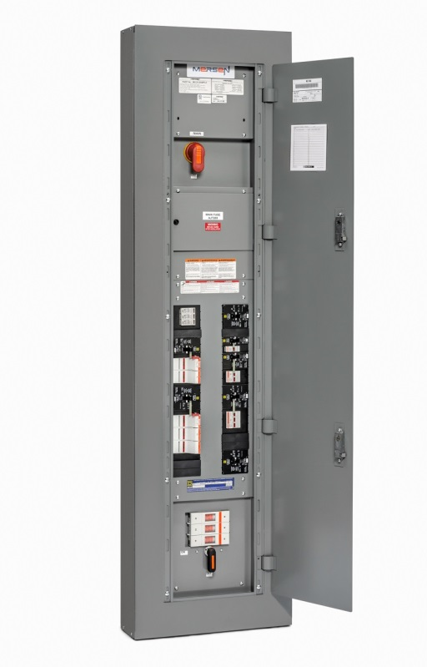

Mersen’s Fused Coordination Panelboard
A Guide to Selective Coordination

Slide 2
Agenda
What is Selective Coordination?
Why is it needed?
Mersen Fused Coordination Panelboard (MFCP)
Selective Coordination Made Easy!
Notes:
In this module we will cover, what selective coordination is, why it is needed, Mersen’s fused coordination panelboard and how it mades selective coordination easy.

Slide 3
What is Selective Coordination?
Localization of an overcurrent condition to
restrict outages, over the full range of available over-currents
    Reduce downtime
    Prevent outages to critical circuits
Notes:
Selective coordination keeps the overcurrent problem from affecting other circuits which can reduce downtime and makes the electrical system more reliable

Slide 4
What is Selective Coordination?
Service
No Selective Coordination
Load
Load
Load
Load
Load
Load
?
Load
Load
Load
Load
Load
Load
Load
Notes:
46
15
If a fault occurs on a load in a system that is not selectively coordinated the closest overcurrent device may or may not open and the next upstream device will open. This will disconnect power to the either branch circuit and unnecessarily disconnect the other loads. In extreme cases it can travel more than one level upstream.

Slide 5
What is Selective Coordination?
Service
✓
Selective Coordination
✓
✓
✓
✓
Load
Load
Load
✓
✓
✓
Load
Load
Load
Load
Notes:
46
15
If a fault occurs on a load in a system that is selectively coordinated only the closest overcurrent device will open and no other circuits will be effected.

Slide 6

Why is it needed?
Good Engineering Practice
  Reduce the blackouts to critical operations
  Reduce cost of maintenance
Important power applications require it per the National Electrical Code (NEC)
  517.26 Health Care
  620.62 Elevators
  645.27 Critical Operations Data Sys
  695.3(C)(3) Campus Fire Pumps
  700.28 Emergency Systems
  701.27 Legally Required Stand by Sys
  708.54 Critical Operations Power Sys
Notes:
Ensuring a system is Selectively coordinated is good engineering practice and will help reduce unnecessary system blackouts and can reduce the cost of system maintenance. It does this by ensuring the closet/lowest amp rating fuse opens. The national electrical code began requiring selective coordination for most critical power applications in 2005

Slide 7

Introducing MFCP!
Innovative branch circuit protection
20, 32, or 42 branch circuits
Only 3 branch fuses
  ATDR30, AJT60, AJT100
  Resettable overload protection
    Circuit Breaker trips on overloads
Standard off the shelf Class J and CC fuses
Standard 20” wide
Notes:
Mersen’s Fused Coordination Panelboard provides and innovative approach at branch circuit protection but using both circuit breakers and fuses. This approach only requires three different branch fuses for all ratings of 15A up to 100A and also utilizes true class J and Class CC fuses. And since space is a premium it is offered as a standard 20” wide panel.

Slide 8
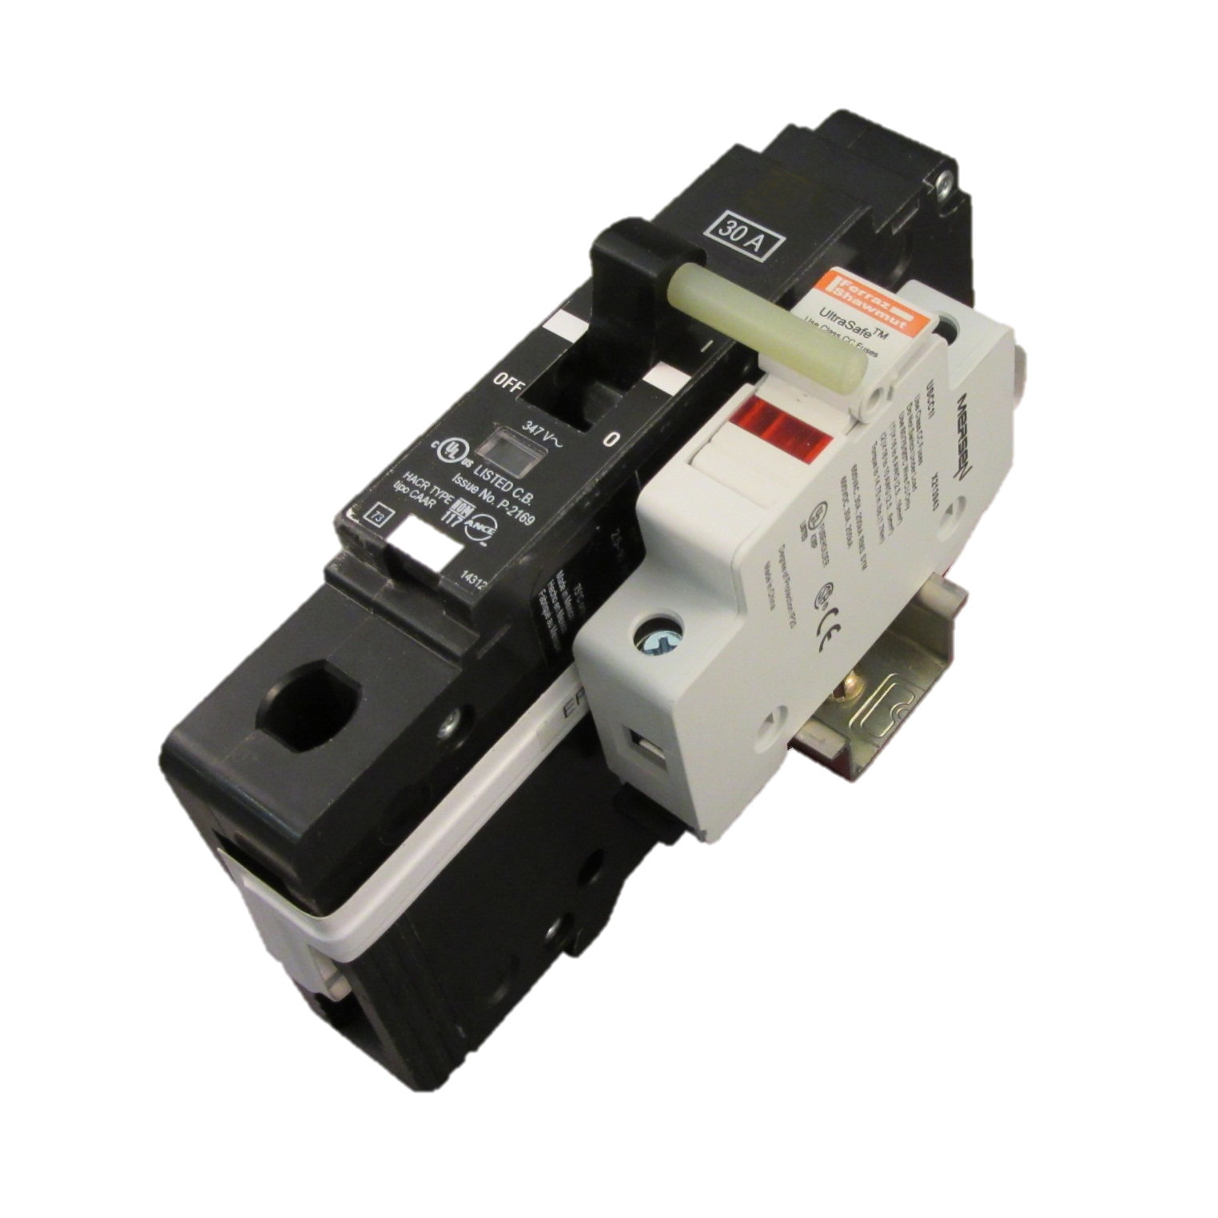
Ultra-Safe® Fuseholders (SC)
15A – 30A -> ATDR30
35A – 60A -> AJT60
70A – 100A -> AJT100
Introducing MFCP!
Mechanically Interlocked
Branch circuit Protection
Circuit Breaker (OL)
15A – 1,2,3 pole
20A – 1,2,3 pole
25A – 1,2,3 pole
30A – 1,2,3 pole
35A – 1,2,3 pole
40A – 1,2,3 pole
45A – 1,2,3 pole
50A – 1,2,3 pole
60A – 1,2,3 pole
70A – 2,3 pole
80A – 2,3 pole
90A – 2,3 pole
100A – 2,3 pole
Insulated Bus bar
Notes:
The UL listed circuit breaker and fuse combination is rated for 200KA. The combination is designed so that the circuit breaker will trip on overload condition and the fuse will only open is a short circuit occurs. They are connected together with an insulated busbar and are mechanically interlocked so the fuse can only be replaced with the power turned off.

Slide 9
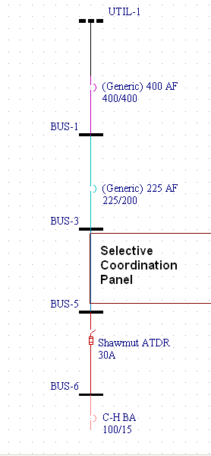
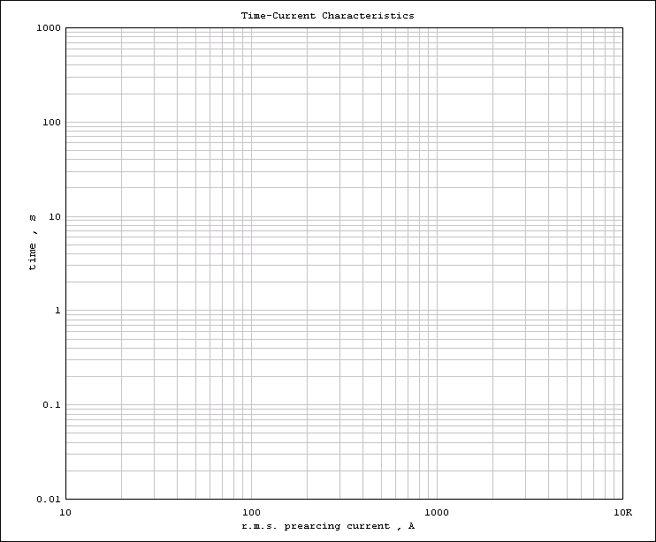


Generic
CB 15A
MFCP-K-30
ATDR30
200A
400A
T-C Curves
Mersen ATDR 30A
ATDR-30
.
Sq D ED 100/15A
Curves courtesy of EasyPower
Notes:
Here are the time current curves for the circuit breaker and fuse for a 15A branch circuit in Mersen’s fused coordination panel. Because they are a UL listed combination we can combined the curves and cut off the portion of the breaker curve where the fuse will clear first and the cut off the portion of the fuse curve where the breaker will clear first.
A completely fusible system is preferred for positive selective coordination with any fault current level. But the Coordination Panel selectively coordinates with most upstream 200 amp molded case circuit breakers when the largest branch circuit is 30 amps or less. With larger branch circuits a more detailed analysis will show the limits of selective coordination.

Slide 10
Selectivity Between Fuses
Branch Fuse
Melt I²t
1500 A²s
Clearing I²t
1000 A²s
Main Fuse
Melting I²t
Clearing I²t
Melting I²t
Notes:
In addition to looking a time current curves a fused system must also compare the branch fuse’s clearing I-squared-T to the main fuse’s Melting I-squared-T to ensure that the branch fuse will clear a fault before the upstream fuse melts.

Slide 11
Selective Coordination Made Easy
Service
A4BQ1000
✓
2:1 Ratio
With Amp-Trap 2000®
AJT200
AJT100
AJT350
A6D500R
✓
✓
✓
✓
MFCP
Load
Load
Load
ATDR30
ATDR30
AJT60
AJT100
✓
✓
✓
X
Load
Load
Load
Load
Load
Notes:
46
15
Using Mersen’s Fused Coordination Panelboard does not guarantee that a system will be selectively coordinated by itself. The system must still be looked at to ensure that the proper fuse ratios are met. In this case all Amp-Trap 2000 fuses are used so a 2:1 ratio must be maintained to ensure the whole system will coordinate.

Slide 12
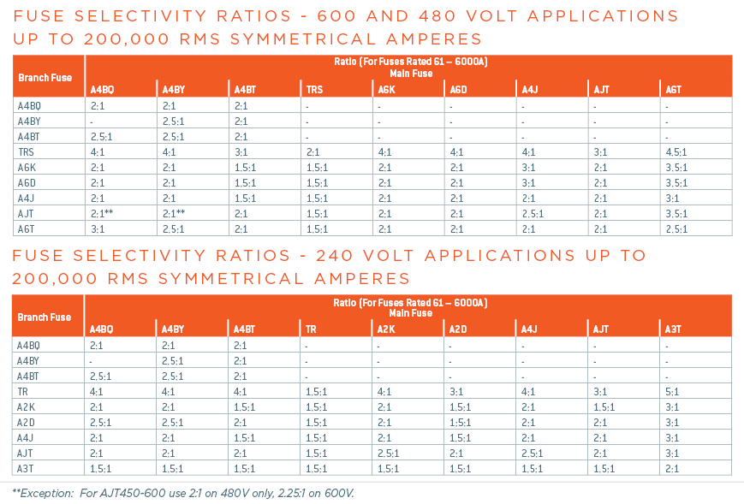
Selective Coordination Made Easy
Easy to coordinate using fuse ratios
  2:1 ratio with Amp-Trap 2000 fuses
Notes:
If the upstream fuse is not an Amp-trap 2000 fuse a 2 to 1 ratio may not apply, here are the ratios for all general purpose fuses

Slide 13

Introducing MFCP!
120/208V, 120/240V,
  277/480V or 347/600V
MLO, Switch with or without fuses
20, 32 or 42 branch circuits
250A or 400A
Surface or flush-mount enclosures
Feed-thru lugs
Specials Available!
Notes:
Mersen’s Fused Coordination panelboard is offered in a variety of configurable options and custom options are available.

Slide 14
Customer Benefits
CB trips instead of Fuse opening with 2X rating
Mersen Panel is UL listed to accept any manufacturer’s Class CC and J fuse
Class CC and J fuses are commonly stocked
Load Connections UL Listed for 2 wires to help with Inspection during last-minute changes
Notes:
Key benefits of Mersen’s Fused Coordination panelboard are that is have resettable overload protection, it is ul listed with standard Class CC and Class J fuses and it is UL listed for 2 wires under one terminal on the load connections.

