Slide 1
HelioProtection®
Solar Power Applications

Slide 2




Application Overview
B

Slide 3
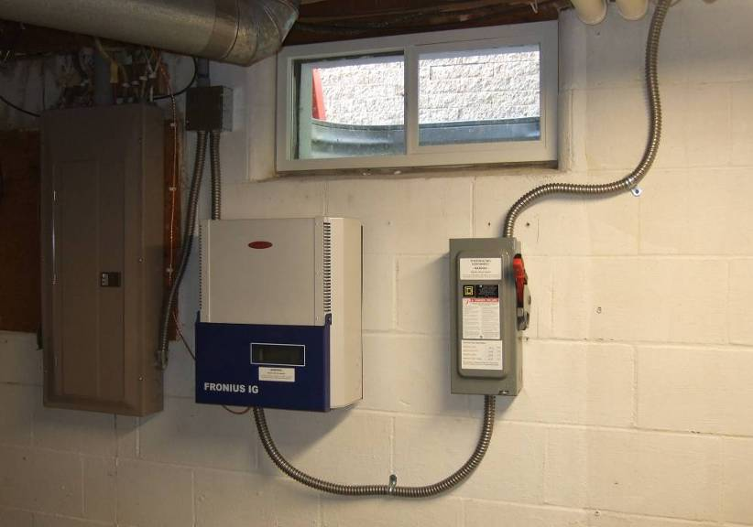
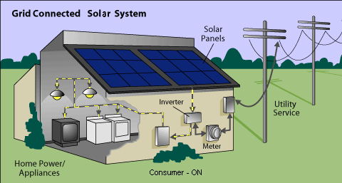
Application Overview
Residential (roof top)
  600 VDC string voltage
  5 kW to 36 kW output power

Slide 4

Architecture 1 – Residential, Micro Inverter
Roof Top - 600Vdc (5kW-36kW)
-
Solar Panel
A1
A2
An
DC
DC
DC
⁺
NEMA AC Junction Box
UL AC Disconnect
Main AC Service Panel
Micro Inverter
Line
AC
AC
AC
-
SW
Z1
Z2
Zn
DC
DC
DC
⁺
Neutral
CB
AC
AC
AC
GND
AC 600Vac Panel Branch Disconnect Switch, AC SPD.
A
B
C
D
Micro-Inverter Spec:
190W – 350W per Module
97% Efficiency MPPT
Built-in Remote Rapid Shut Down
120 Modules (30 Modules x 4 Strings) in total for 36kW
Optional- AC Fuse for 2 Phase Inverter, AC SPD
AC 600Vac Disconnect Switch, AC SPD
(Not offered: AC contactor)
Note:
Some systems May have Fuse Coordination Panel instead of Circuit Breakers in C.
AC 600Vac disconnect switch

Slide 5
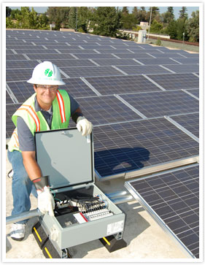
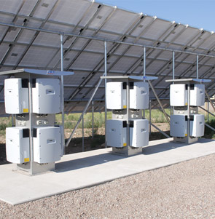
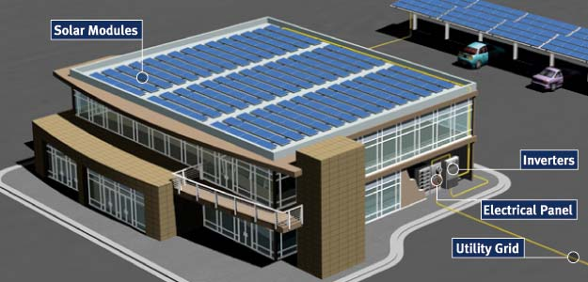
Application Overview
Commercial (Roof top)
  Office / Mfg buildings
  600 & 1,000 VDC string voltages
  36 kW to 250 kW output power

Slide 6

Architecture 2 – Commercial, String Inverter
Roof Top – 600Vdc & 1000Vdc max. (36kW-250kW)
⁺
DC UL Fuse Combiner
UL DC Disconnect
DC/AC String Inverter
Main AC Service Panel
Solar Panel
A1
A2
An
Line
DC
DC
DC
AC
B1
B2
Bn
Line
DC
DC
DC
C1
C2
Cn
ESS
Neutral
DC
DC
DC
DC
⁻
A1—An Solar Modules in series, A—C series in Parallel
DC Cable inline Fuse (Cap Crimp)
A
DC Fuse,
DC PV Fuse holder PDBs, DC SPD
B
D
E
AC SPD/ 600Vac Switch
DC Switch
C
GND
DC Fuse, SPD
DC PV Fuse holder
 | Modules | 24 |  | Array | 5
A |  | B |  | C
Module Specs |  | String Specs |  | Array Specs
Pmp (W) | 330 | 7920 |  | 39600
Vmp (V) | 39 | 936 |  | 936
Imp (A) | 8.46 | 8.46 |  | 42.31
Voc (V) | 46.8 | 1123.2 |  | 1123.2
Isc (A) | 9.15 | 9.15 |  | 40.75
 | Modules | 38 |  | Array | 24
A |  | B |  | C
Module Specs |  | String Specs |  | Array Specs
Pmp (W) | 330 | 12540 |  | 300960
Vmp (V) | 39 | 1482 |  | 1482
Imp (A) | 8.46 | 8.46 |  | 203.08
Voc (V) | 46.8 | 1778.4 |  | 1778.4
Isc (A) | 9.15 | 9.15 |  | 195.6
Note:
Systems may have B and C together for fused disconnect switches
Systems may have A with inline cable fuse that may eliminate B fuse combiner
ESS – DC Energy Storage System

Slide 7
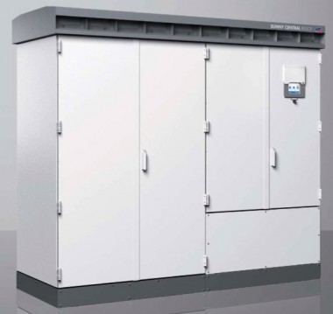
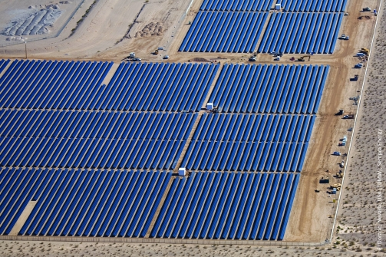
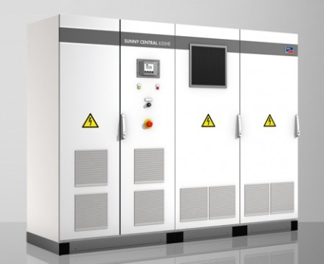
Application Overview
Solar Farm (Utility)
  1,000 & 1,500 VDC string voltages
  250 kW and higher output power

Slide 8
Architecture 3 – Utility, Central Inverter
Ground Mount – 1000Vdc & 1500Vdc max. (>250kW)
⁺
DC UL Fuse
Combiner
DC UL Fuse
ReCombiner
UL DC 2nd Disconnect
DC/AC Central Inverter
Solar Panel
A1
An
UL DC Disconnect
DC
DC
ESS
DC
Z1
Zn
DC
DC
⁻
AC
A1—An Solar Modules in series, A—Z series in Parallel
DC UL Fuse
Combiner
G
F
D
Solar Panel
⁺
UL DC Disconnect
GND
a1
an
DC
DC
DC Fuse High Current,
DC Open Style Fuse Holder,
PDBs, DC SPD
High Voltage, High Current DC Switch
DC Fuse, SPD
DC PV Fuse holder
z1
zn
DC
DC
Main AC Service Panel
⁻
E
Note:
Systems may have G and F integrated into D
Systems may have A with inline cable fuse that may eliminate B fuse combiner
ESS – DC Energy Storage System
DC Fuse,
DC PV Fuse holder PDBs, DC SPD
AC 600Vac Switch, AC SPD, MV Fuse
DC Cable inline Fuse (Cap Crimp)
A
B
DC
Switch
C
Combiner Box with Arc Flash Fault Protection and Ground Fault Protection per NEC 2017
AC MV Grid Connection

Slide 9
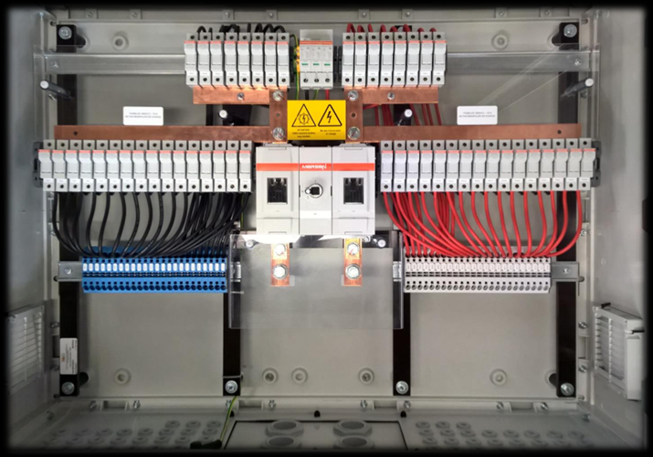
Application Overview
String Combiner Box

Slide 10
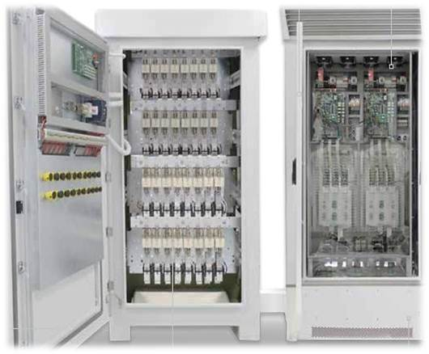
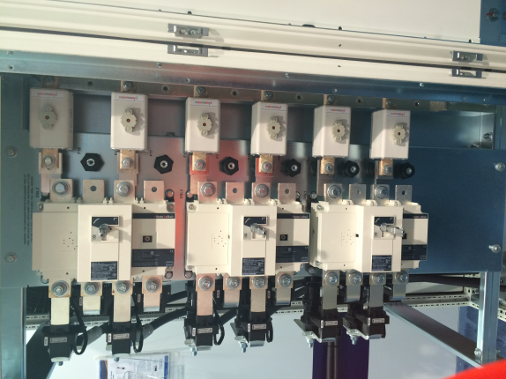
Application Overview
Re-Combiner (AC/DC Master Combiner)

Slide 11
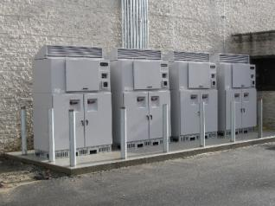
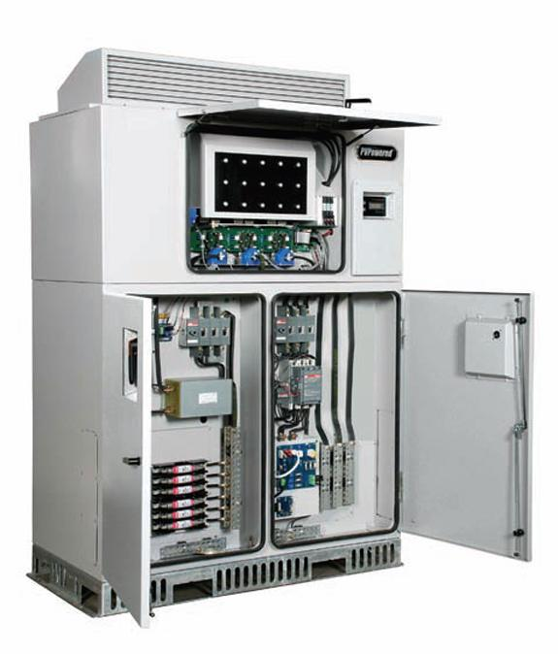
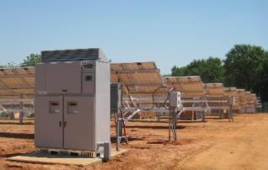
Application Overview
PV Inverter (DC/AC)
  Micro inverter (module level)
  String inverter (string level)
  Central inverter (array level)

Slide 12
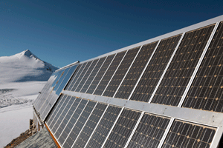

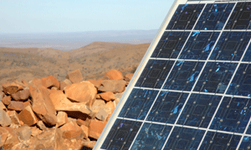
Application Overview
What Makes this Market / Application Unique?
  The Environment
    Outdoors: High exposure to fluctuations in temperature,
    humidity, power cycling, and pollution
  The Integrator and End User Expectations
    Longevity: 20⁺ Year Warranty
    Maximized output
    Readily available
    replacement parts

Slide 13
Application Overview
What Makes this Market / Application Unique?
  Main focus is on DC voltage and current generated from PV modules configured into “strings” and “arrays”
    Inverter AC output requirements based on UL 1741
  NEC Article 690
    Added extensive DC and AC application and installation requirements for photovoltaic energy systems
    Rapid Shutdown now required for rooftop installations
  Dedicated UL and IEC Product Standards
    Fuses: UL2579 (USA), CSA 22.2 (CAN), IEC 60269-6 (ROW)
    Fuse holders: UL4248-19 (USA), CSA 22.2 (CAN), IEC 60269-2 (ROW)
    Switches: UL98B (USA), CSA 22.2 (CAN), IEC 60947-3 (ROW)

Slide 14
Current Trends in PV Systems Deployment
Drastic cost reduction in PV modules
  $4.50/Watt  $0.40/Watt over a three year period
Increase in PV string operating voltage
  600 VDC  1,000 VDC (Commercial roof top)
  1,000 VDC  1,500 VDC (Utility solar “farms”)
Solid growth in Roof top installations (commercial and residential)
  For the first time, electrical energy consumers can become producers
    Exploit “Peak Shaving” techniques to reduce utility energy consumption costs
    Potential to earn revenue by selling excess electrical energy to grid network operators
Targeted cost reductions in Utility scale electrical Balance of System (eBOS) components
  Conversion from combiner boxes to in-line fusing
  Increased aggregation of string cabling to reduce combiner box count

Slide 15
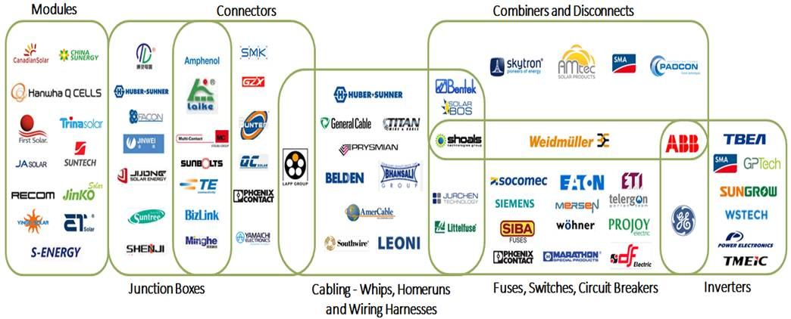
PV Supplier Ecosystem
Mersen Space

Slide 16
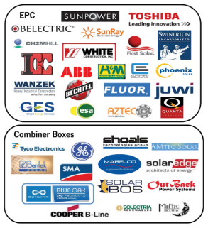
Customer Groups – Overview
EPC (Engineering, Procurement, Construction)
  Delivers end-to-end PV system design, construction, and installation
  Some also provide service and maintenance (MRO)
Primary Subsystems
  Inverter OEMs
  Battery Energy Storage System (BESS) manufacturers
eBOS supply ecosystem (initial installation)
  UL1741 certified combiner box manufacturers
  Molded PV cable harness manufacturers
  Full energy mgt./distribution systems (disconnect, combiner/recombiner, etc.)
Maintenance, Repair, Operations (MRO)
  PV focused distributors
  Energy Management and Maintenance service providers
Notes:
Each customer group requires its own commercial playbook
Build-to-print manufacturers are not customers, because they do not control the BOM
Top Solar Contractors website link: www.solarpowerworldonline.com

Slide 17
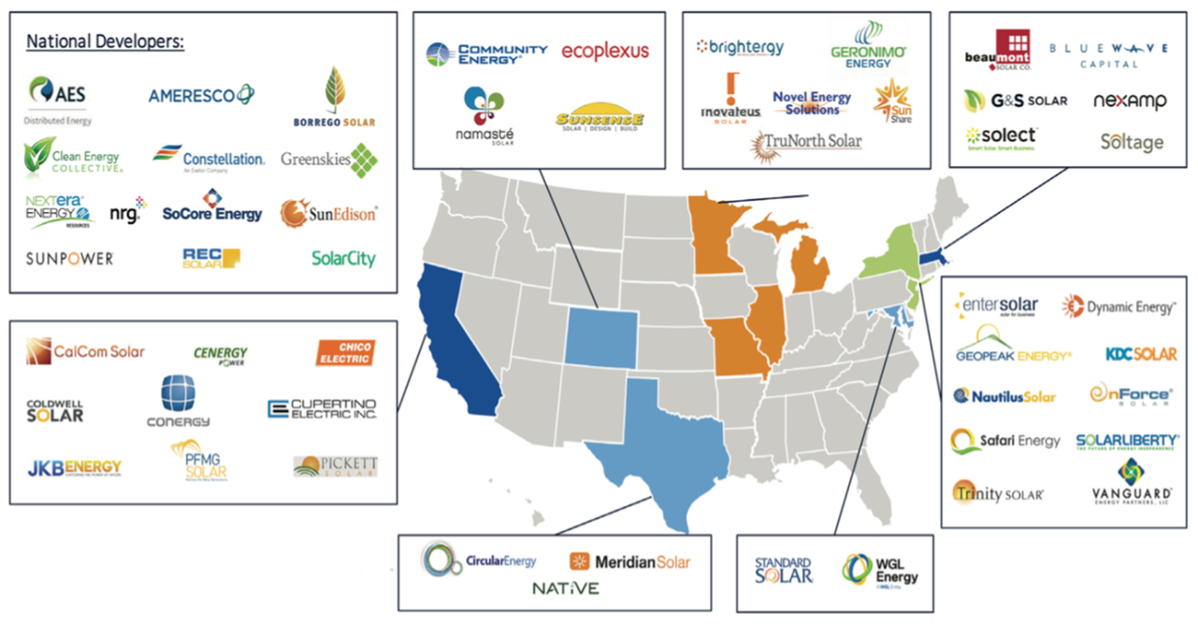
Customer Overview (EPC)
PV Engineering, Procurement, and Construction: Tier 1 PV EPC firms provide end-to-end solutions and services for utility scale PV systems, and may also provide Maintenance services

Slide 18
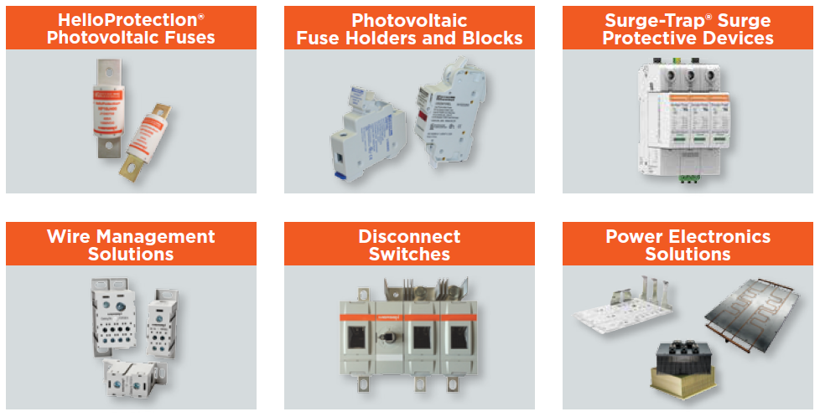
HelioProtection® Product Offering

Slide 19
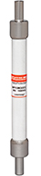
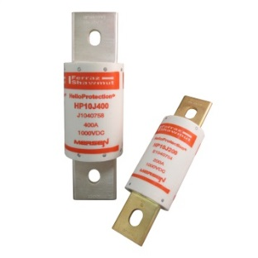
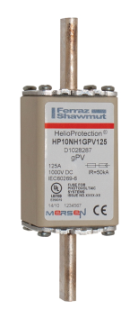
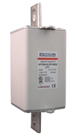


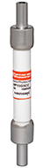
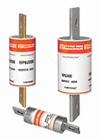
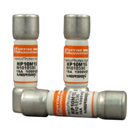
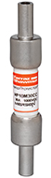
HelioProtection® Product Offering
Fuses
Series | HP6M/10M* | HP15M* | HP15G* | HP6J | HP10J | HP10NH | HP15NH
Application | String or Module Protection | String or Module Protection | String or Module Protection | Array or Inverter Input Protection | Array or Inverter Input Protection | Array or Inverter Input Protection | Array or Inverter Input Protection
Voltage | 600 & 1k VDC | 1500VDC | 1500VDC | 600VDC | 1000VDC | 1000VDC | 1500VDC
Amperage | 1-32A | 4-32A | 2.5-5A | 70-400A | 70-600A | 50-250A | 160-400A
Size | Midget (10x38mm) | Midget (10x85mm) | Midget (10x57mm) | Class J | Class J | NH1, NH2 | NH3L
* Available with Crimp Cap wire crimp terminals for in-line fuse applications

Slide 20

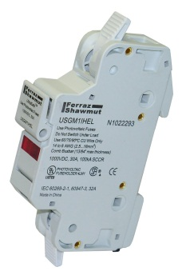
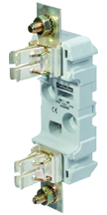
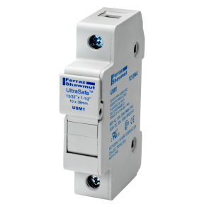
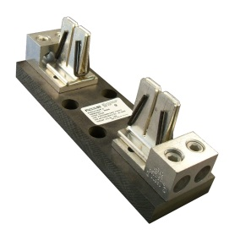
HelioProtection® Product Offering
Fuse holders and Blocks
Series | US15M | US10M | USG | HPJ | HPBB
Application | String or Module Protection | String or Module Protection | String or Module Protection | Array or Inverter Input Protection | Array or Inverter Input Protection
Voltage | 1500VDC | 1000VDC | 1000VDC | 1000VDC | 1500VDC
Amperage | 32A max | 32A max | 32A max | 70-400A | 70-400A
Size | Midget (10x85mm) | Midget (10x38mm) | Midget (10x38mm) | Class J | NH

Slide 21
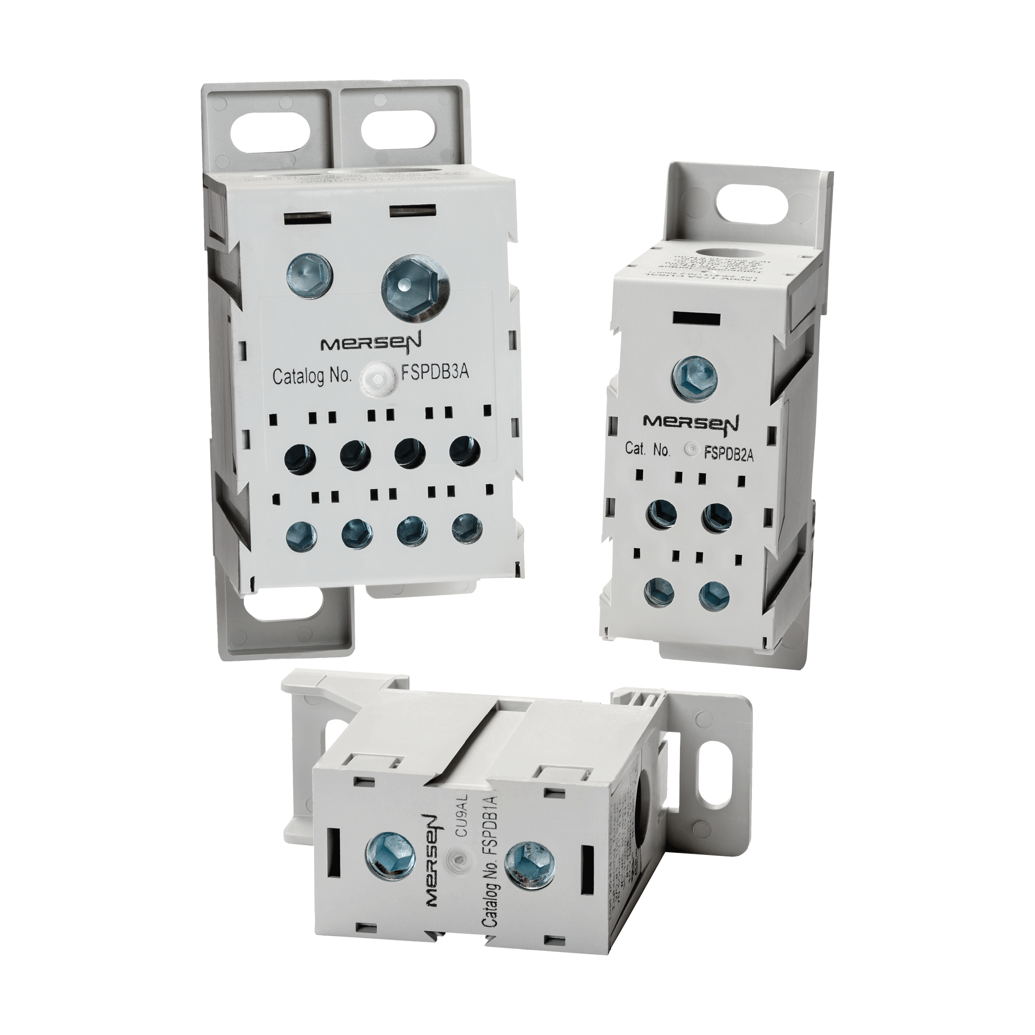
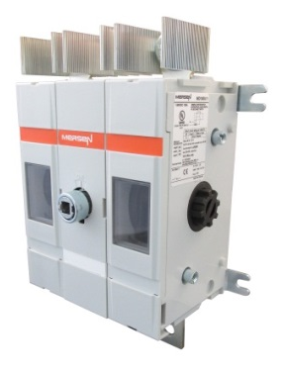
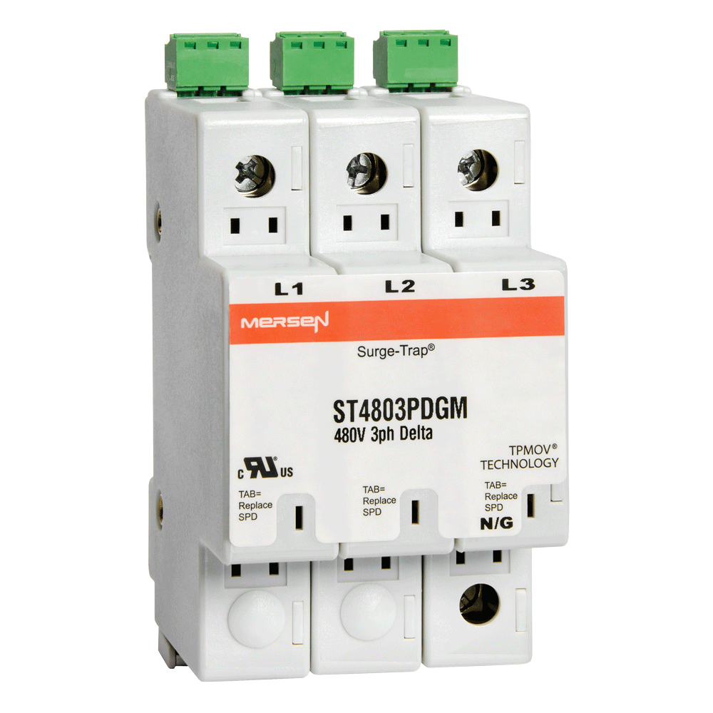
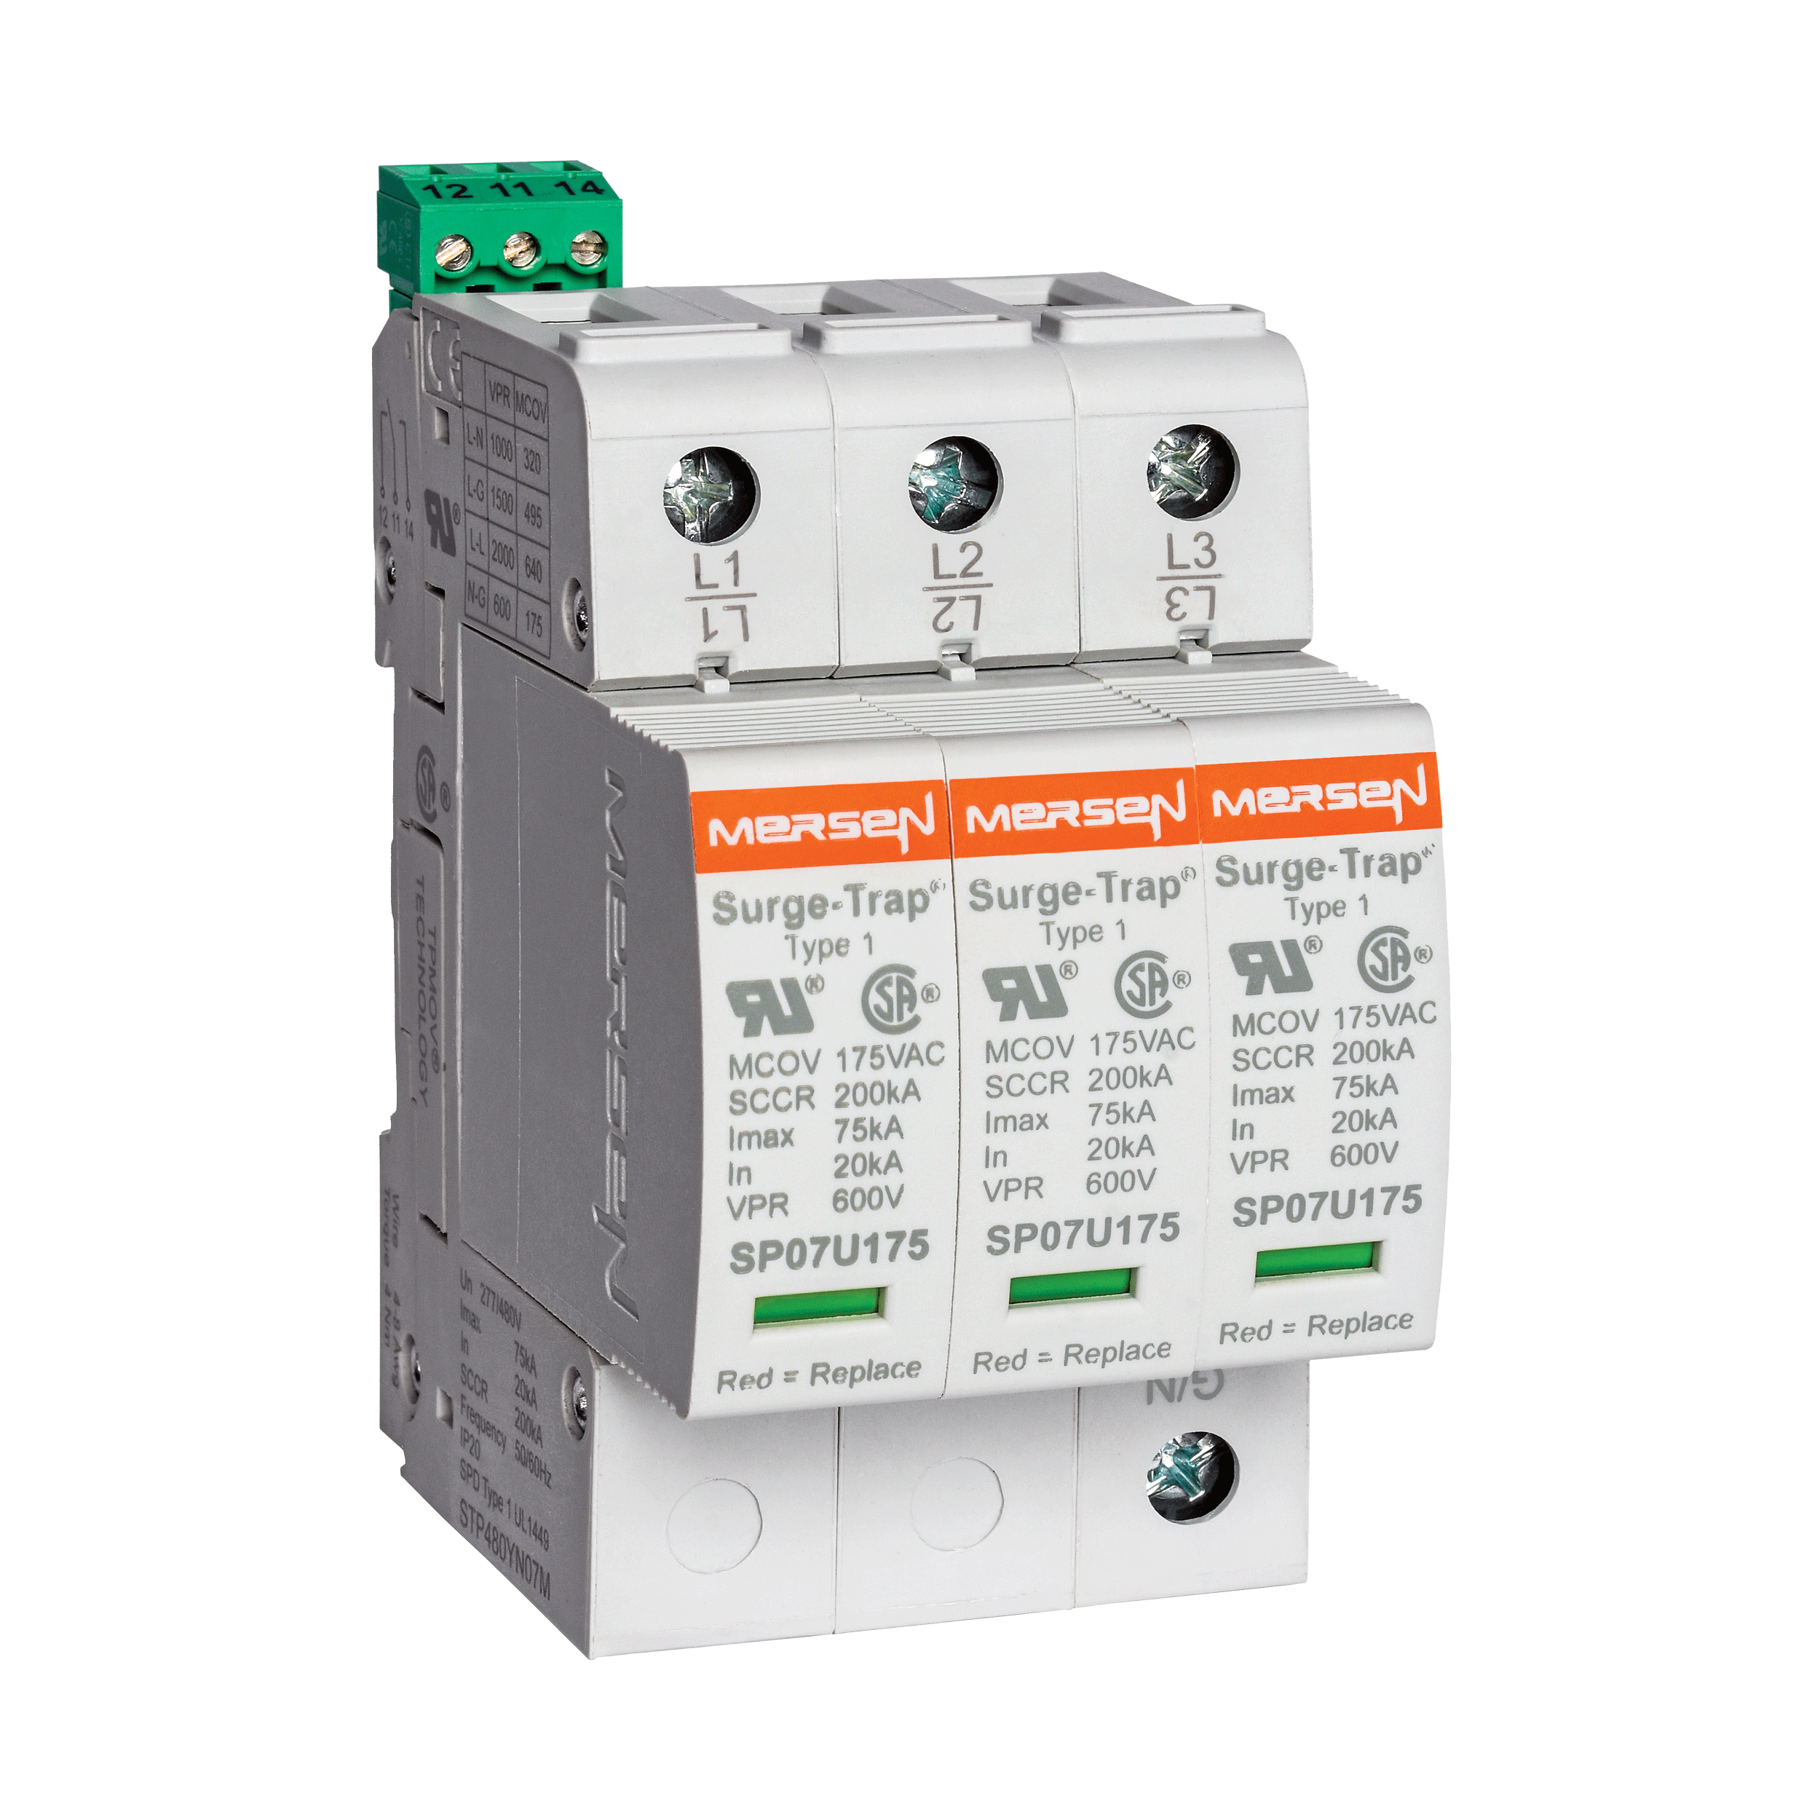
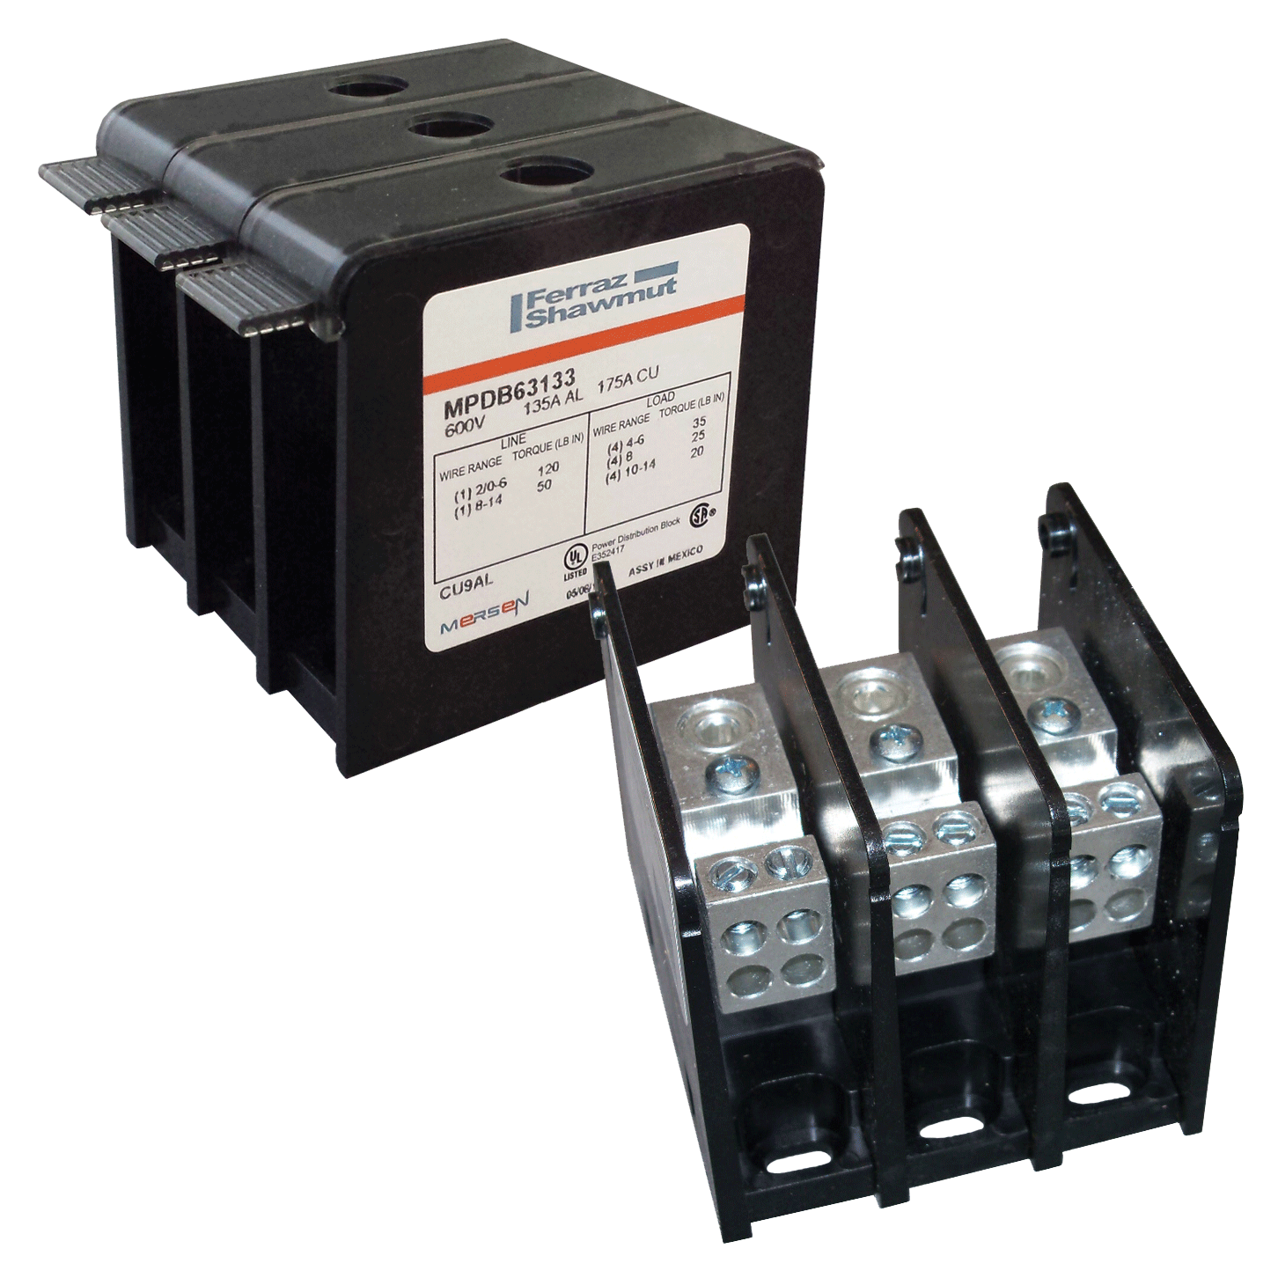
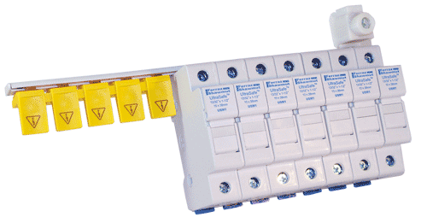
HelioProtection® Product Offering
Surge Protection, Wire Management, DC Disconnects
Series | ST | STP | MPDB | FSPDB | USBB | MD___U__
Application | Surge Protection | Surge Protection | Combining Circuit | Combining Circuit | Combining Circuit | DC Disconnecting
Voltage | 1000VDC | 1500VDC | 1000VDC | 1500VDC | 1000VDC | 1000VDC
Type | Modular | Pluggable | Open-Style | Finger-Safe | Comb Busbar Finger-Safe | 100A – 400A

Slide 22
Why HelioProtection®?
Easy PV Product Identification and Selection
  Dedicated PV brand delivers easy specification and selection
Meets Latest Industry Standards
  UL 2579 – Fuses for Photovoltaic Systems
  UL 4248-19 – Photovoltaic Fuse holders
  UL 98B – Switches for use in Photovoltaic Systems
  UL 248-13 – Semiconductor/Special Purpose Fuses
  UL 1449 3rd Edition – Surge Protective Devices
  IEC 60269-2 – Photovoltaic Fuse holders
  IEC 60947-3 – Switches for use in Photovoltaic Systems
Complete Packaged Solutions
  The only manufacturer to offer fuses, fuse holders, SPDs, switches, wire management, cooling solutions, bus bars, and safety solutions

Slide 23
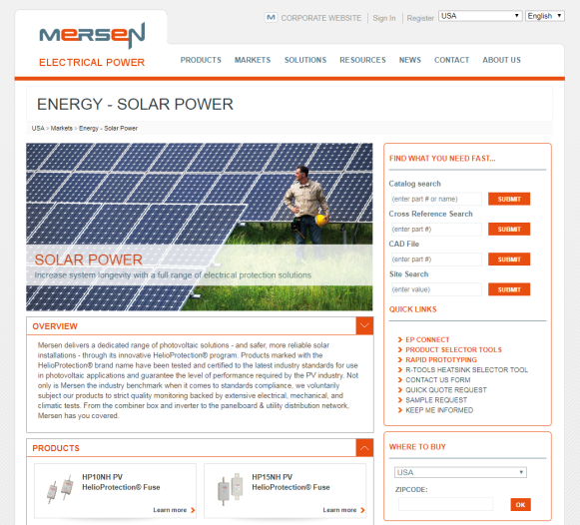
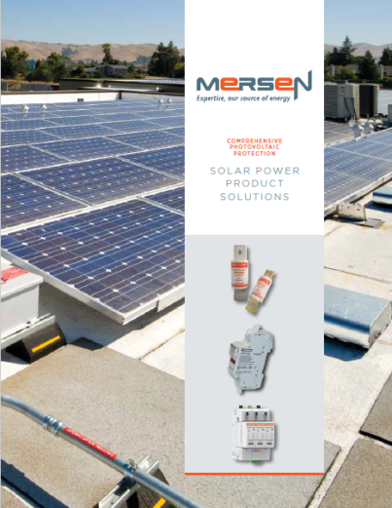
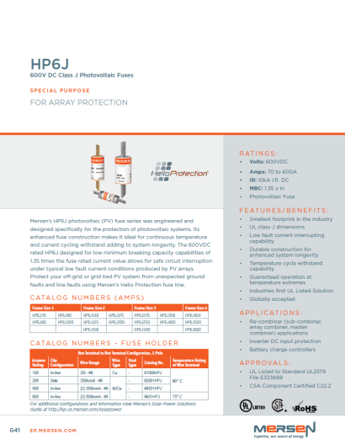
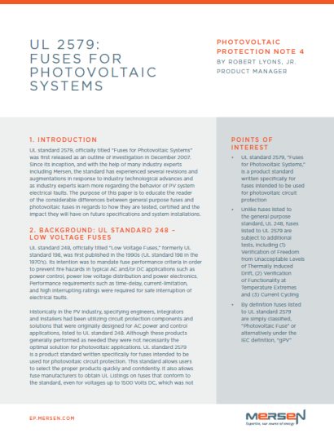
Product Resources
Collateral and Sales Tools
  Solar Homepage (ep-us.mersen.com/markets/energy-solar-power)
  Solar Power Solutions Guide
  Data Sheets
  Product Performance Data
  Tech Topics, White Papers, Articles
  E-Learning Modules

